Slide 1
BERT: Pre-training of Deep Bidirectional Transformer for Language Understanding
Google AI Language
Presented by: 艾查妮

Slide 2
Outline
Pre-requisite Knowledge
Introduction to BERT
BERT Architecture
Transformer Encoder
Pre-Training Procedure
Experiments
Results
Conclusion

Slide 3
Introduction to NLP

Slide 4

What is Natural Language Processing?
A field of computer science, artificial intelligence and computational linguistics to perform useful tasks involving human languages
Human to Machine communication
Improving human-human communication
Extracting information from texts.
Highly ambiguous
Sentence I made her duck may have different meanings
I cooked waterfowl for her
I cooked waterfowl belong to her
I created the (plaster) duck she owns.
I caused her to quickly lower her head or body.

Slide 5
Why is NLP hard?
Word segmentation
Part of Speech (POS)
Lexical Analysis
Syntactic Analysis
Semantic Analysis
Discourse integration
It is the vocabulary that includes words and expressions
It involves analysis of words in a sentence to depict the grammatical structure of the sentence
It abstracts the dictionary meaning or exact the meaning from the context
Sense the context based on the previous sentence
It divides a text into paragraphs, sentences and words
“The girl the go to the school”
“colorless blue idea”
“She wanted it”

Slide 6
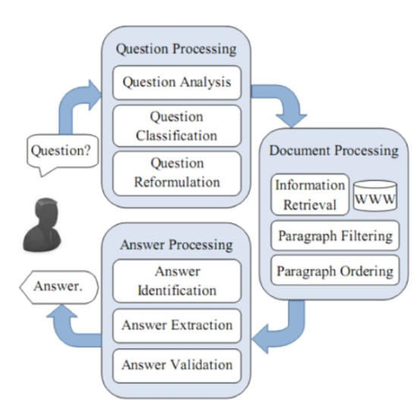
NLP Applications
Question Answering
Text Summarization
Machine Translation
Distilling the most important information from text
The process of translating one language to the other one.
Categories
Google Translation
Single/Multi-document Summarization
The future looks surprisingly bright due to his hard work.
Extractive/Abstractive Summarization
由於他的辛勤工作，未來看起來非常光明
Query-focused text Summarization

Slide 7
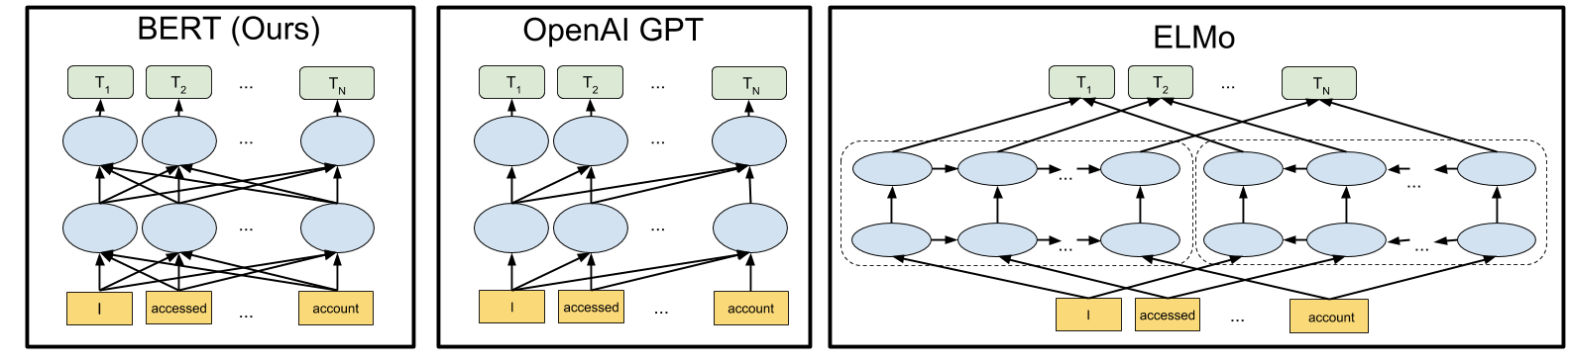
Limitations of Current Techniques
There are two existing strategies for applying pre-training language representation:
→ Feature based (ELMO)
→ Fine tuning (Open AI GPT, Generative Pre-trained Transformer)

Slide 8
BERT: Bidirectional Encoder Representation from Transformer

Slide 9
BERT
Bidirectional
Encoder
Representation
Transformer
It can read from both directions left as well as right to gain better understanding of the text
This architecture is already well known as Encoder-Decoder for NLP tasks e.g. Seq2Seq and Machine Translation
Encoder-Decoder architecture is represented as Transformer
key component is Multi-head attention block. It is combination of attention + normalization +masked attention in decoder phase

Slide 10
BERT: Bidirectional Encoder Representation from Transformer
Main Ideas
Propose a new pre-training objective so that a deep bidirectional transformer can be trained.
The “masked language model” (MLM): the objective is to predict the original word of a masked word based only on its context.
“Next sentence prediction”
Merits of BERT
Fine-tune BERT model for specific tasks to achieve state-of-the-art performance.
BERT advances the state-of-the-art for 11 NLP tasks

Slide 11
BERT architecture
BERT’s model architecture is a multi-layer bidirectional transformer encoder
(Vaswani et al., 2017) “Attention is all you need”
Two models with different sizes were investigates
BERT_{base}: L=12, H=768, A=12, Total Parameters = 110M
BERT_{large}: L=24, H=1024, A=16, Total Parameters=340M
L: number of layers (Transformer blocks), H: hidden size A: number of self-attention heads

Slide 12
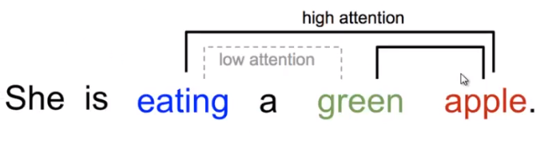
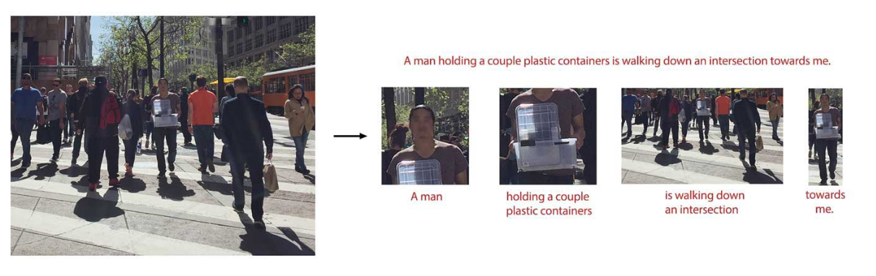
Concept of Attention
Name | Definition | Citation
Self Attention | Relating different positions of the same input sequence | Cheng2016
Global/Soft | Attending to the entire input state space | Xu2015
Local/Hard | Attending to the part of the input state space | Xu2015, Luong2015

Slide 13
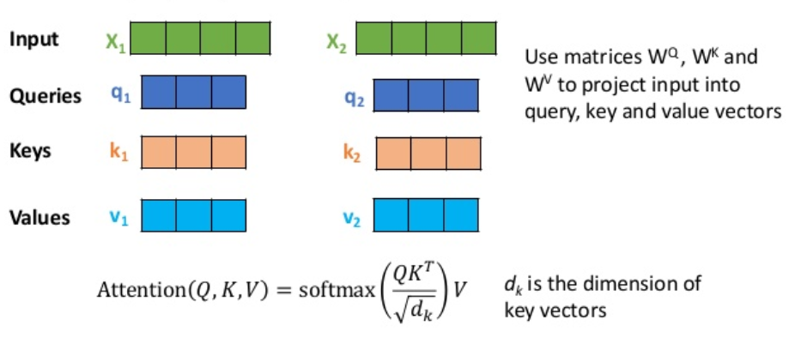
Self-Attention in Detail
Attention maps a query and a set of key-value pairs to an output
Query, keys and output are all vectors
Q: Previous Decoder
Hidden state
K: Encoder Hidden State
V: Encoder Hidden State

Slide 14
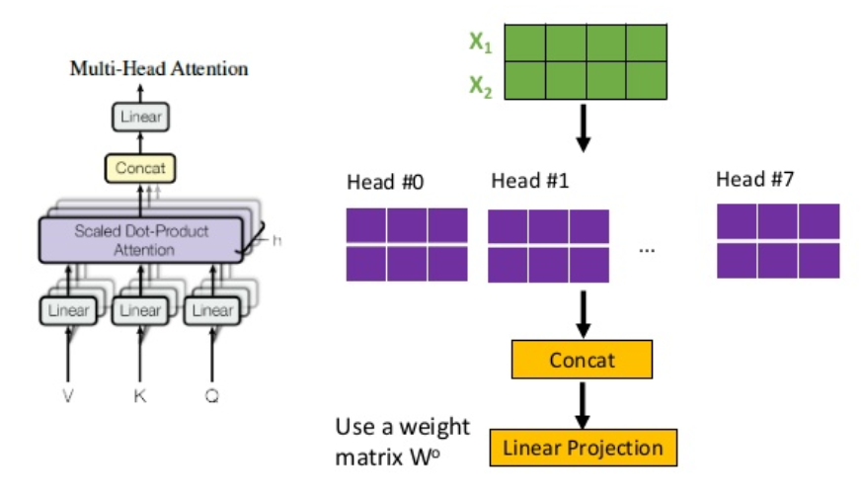
Multi-head Attention

Slide 15
Inside an Encoder Block
In BERT experiments, the number of blocks N was chosen to be 12 and 24.
Blocks do not share weights with each other
Add & Norm
Feed Forward
Add & Norm
Multi-Head Attention
Positional Encoding
Input Embedding
Input

Slide 16
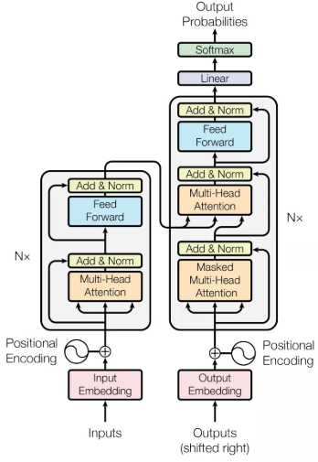
Inside an Encoder Decoder Block
Residual Connection and Layer Normalization
Multi-Head Attention
Decoder
Encoder
Multi-Head Attention
Masked Multi-Head Attention

Slide 17
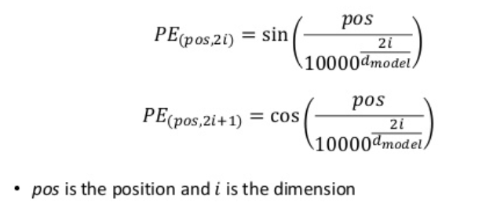
Position Encoding
Position Encoding is used to make use of the order of the sequence
Since the model contains no recurrence and no convolution
In Vawasni et al., 2017, authors used sine and cosine functions of different frequencies

Slide 18
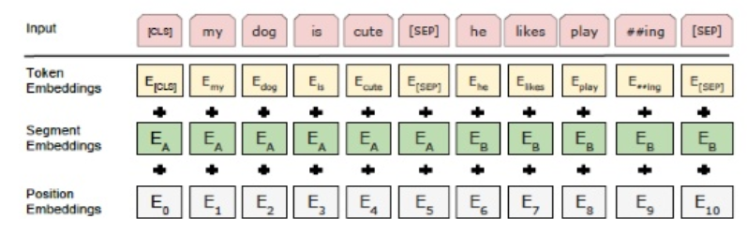
Input Representation
Token Embedding: Use pre-trained WordPiece embedding.
Position Embedding: Use learned Position Embedding
Added sentence embedding to every tokens of each sentence.
Use [CLS] for the classification tasks
Separate sentences by using a special token [SEP]

Slide 19
Pre-training procedure
Training data: BooksCorpus (800M words) + English Wikipedia (2,500M words)
To generate each training input sequences: sample two spans of text (A and B) from the corpus
The combined length is < 500 tokens
50% B is the actual next sentence that follows A and 50% of the time it is a random sentence from the corpus
The training loss is the sum of the mean masked LM likelihood and the mean next sentence prediction likelihood

Slide 20
Task#1: Masked LM
15% of the words are masked at random
Not all tokens were masked in the same way (example sentence “My dog is hairy”)
80% were replaced by the <MASK> token: “My dog is <MASK>”
10% were replaced by a random token: “My dog is apple”
10% were left intact: “My dog is hairy”

Slide 21
Task#2: Next Sentence Prediction
Motivation: Many downstream tasks are based on understanding the relationship between two text sentences
Question Answering (QA) and Natural Language Inference (NLI)
Language modeling does not directly capture that relationship
The task is pre-training binarized next sentence prediction task
Input = [CLS] the man went to [MASK] store [SEP] he bought a gallon [MASK] milk [SEP]
Label = isNext
Input = [CLS] the man [MASK] to the store [SEP] penguin [MASK] are flight ##less birds [SEP]
Label = NotNext

Slide 22
Fine-tuning procedure
Classification tasks such as sentiment analysis are done similarly to Next Sentence classification, by adding a classification layer on top of the Transformer output for the [CLS] token.
In Question Answering tasks (e.g. SQuAD v1.1), the software receives a question regarding a text sequence and is required to mark the answer in the sequence. Using BERT, a Q&A model can be trained by learning two extra vectors that mark the beginning and the end of the answer.
In Named Entity Recognition (NER), the software receives a text sequence and is required to mark the various types of entities (Person, Organization, Date, etc) that appear in the text. Using BERT, a NER model can be trained by feeding the output vector of each token into a classification layer that predicts the NER label.

Slide 23
Comparison of BERT and OpenAI GPT
OpenAI GPT | BERT
Trained on BookCorpus (800M) | Trained on BooksCorpus (800M) + Wikipedia (2,500M)
Use sentence separator ([SEP]) and classifier token ([CLS]) only at fine-tuning time | BERT learns [SEP], [CLS] and sentence A/B embedding during pre-training
Trained for 1M steps with a batch-size of 32,000 words | Trained for 1M steps with a batch-size of 128,000 words
Use the same learning rate of 5e-5 for all fine-tuning experiments | BERT choose a task-specific learning rate which performs the best on the development set

Slide 24
Results

Slide 25
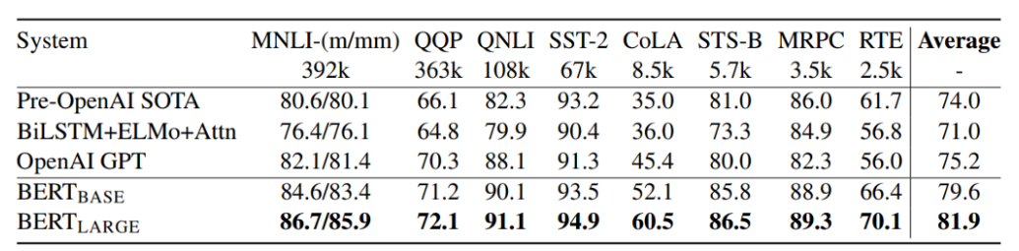
GLUE Results
Question Natural Language Inference is a version of Stanford Question Answering Dataset which has been converted into binary classification task. The positive examples are pairs which do contain the correct answer and negative examples are from the same paragraph which do not contain the answer
Multi-Genre Natural Language Inference is a large classification task. Given a pair of sentence, the goal is to predict whether the second sentence is an entailment, contradiction or neutral with respect to the first one
Corpus of Linguistic Acceptability is a binary single sentence classification task, where the goal is to predict whether an English sentence is linguistically “acceptable” or not
Stanford Sentiment Treebank is a binary single-sentence classification task consisting of sentences extracted from movie reviews
Semantic Textual Similarity Benchmark is a collection of sentence pairs drawn from news headline and other sources
Microsoft Research Paraphrase Corpus consists of sentence pairs automatically extracted from online news sources.
Recognizing Textual Entailment is a binary entailment task similar to MNLI but with less training data
Quora Question Pairs is the binary classification task where the goal is to predict if two questions asked on Quora are semantically equivalent or not?
GLUE benchmark includes the following datasets.

Slide 26
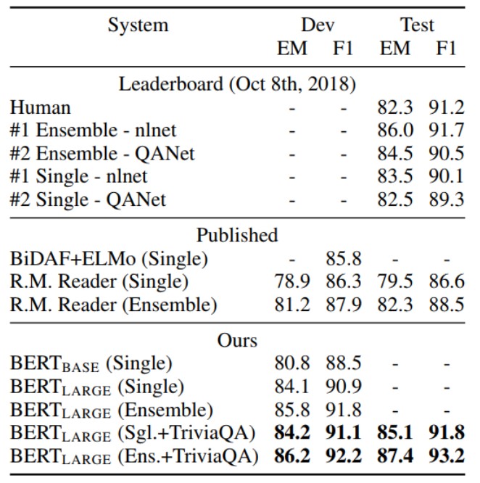
SQuAD v1.1
Stanford Question Answering Dataset is a collection of 100k crowdsourced question/answer pairs.
Given a question and a passage from Wikipedia containing the answer, the task is to predict the answer text span in the passage.

Slide 27
Conclusions
Unsupervised pre-training (pre-training language model) is increasingly adopted in many NLP tasks
Major contribution of the paper is proposed a deep bidirectional architecture from Transformer
Advance state-of-the-art for many important NLP tasks

Slide 28
References
Jacob Devlin , Google AI Language, “BERT: Pre-training of Deep Bidirectional Transformers for Language Understanding”
Ashish Vaswani et al., Cornel University, “Attention is all you need”, 2017.
https://zhuanlan.zhihu.com/p/47812375
https://towardsdatascience.com/bert-explained-state-of-the-art-language-model-for-nlp-f8b21a9b6270

Slide 29
谢谢!
Any Question??

